Slide 1
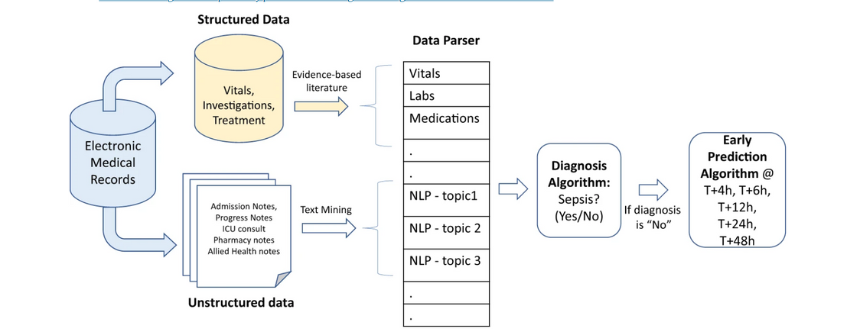
CP302
AI ML in Early Detection of Sepsis
Midsem Presentation
By GOWTHAM RAJU
Dr . NEHA SARDANA
Notes:
1

Slide 2

Introduction
“Sepsis is a life-threatening infection response that rapidly leads to organ failure, especially dangerous in newborns.”
In neonates: immune system is immature → rapid deterioration possible.
Two types: Early-Onset (EOS, <72h) and Late-Onset (LOS, >72h).
Neonatal sepsis is a major cause of NICU deaths and long-term complications.
Early detection and treatment save lives, while delays — especially in culture-negative cases — lead to poor outcomes.
The solution is to develop AI/ML models that detect sepsis risk hours in advance. This supports clinicians in deciding when to initiate treatment, reducing delays and unnecessary interventions.

Slide 3
Data Sources & Key Signals
Data Sources & Key Signals
Vital Signs
Demographic and Laboratory
Clinical Data
1.Heart rate (HR)
2.Oxygen saturation (SpO₂) & pulse rate
3.Respiratory rate (RR)
4.Blood pressure (BP)
5.Temperature
6.Heart rate variability (HRV
HR + SpO₂
1.Gestational age & birth weight
2.Age after birth
3.Sex
4.Race/ethnicity
5.Routine tests
6.Cytokines
Other biomarkers
1.Increase risk (Central lines, mechanical ventilation, some medications)
2.Decrease risk( Exclusive human milk diet, probiotics. )

Slide 4
Existing Approaches / Prior Work
1. HeRO / HRC Index
How: ECG → HR variability + decelerations.
Output: Risk score = fold-increase in sepsis risk (next 24h).
Result: RCT showed reduced sepsis-related mortality.
2. Multisignal Models (HR + SpO₂)
How: Combine HR & SpO₂; measure cross-correlation.
Output: Probability of sepsis in next 6–24h.
Result: Strong predictor; improves accuracy vs single signals.
3. Adult ML Models
How: Use vitals + labs + demographics in ML algorithms.
Output: Risk score/alert for impending sepsis.
Result: ~70–80% sensitivity, ~60–70% specificity; limited generalization.

Slide 5
Challenges in Early Detection
1. False Positives
HR/SpO₂ instability can arise from non-infectious causes (apnea, IVH, lung disease).
Leads to unnecessary cultures and antibiotic exposure.
.
2. Alarm Fatigue
Frequent false alerts overwhelm staff, reduce trust in system.
Need smart thresholds & cooldown periods.
3. Model-Building Challenges
Small datasets; class imbalance (few sepsis cases vs many non-sepsis).
Risk of overfitting if not validated externally.
Difficult to define “ground truth” labels (culture-negative sepsis, variable clinical diagnosis).

Slide 6
Proposed AI/ML Model
1. What We Improve
Beyond HeRO: HeRO only used HR variability; our model integrates HR + SpO₂ + clinical/lab trends, capturing richer physiologic signatures.
Beyond Adult Models: Adult models rely on labs/EHR, often too late; we use real-time NICU monitoring data for earlier prediction.
2. Key Features
HR Dynamics: variability, transient decelerations, apnea–brady clusters.
SpO₂ Patterns: desaturation frequency, duration, recovery speed.
Coupled Signals: rolling HR–SpO₂ cross-correlation (strongest neonatal predictor).
Lab Trends: rising CRP, falling platelets, WBC shifts.
Context: gestational age, line/ventilation days, feeding status.
3. Model Design
Prediction Horizon: 6h, 12h, 24h windows → multiple early warnings.
Algorithms: start with interpretable baselines (logistic regression, XGBoost), scale to temporal CNN/LSTM for waveform learning.
Output: calibrated risk score with top feature explanations → not a black box.
4. NICU Impact
Fewer false positives by combining multisignal + lab context → avoids “cry wolf” alarms.
Early actionable alerts so clinicians can intervene before organ dysfunction.
Supports antibiotic stewardship → encourages treatment only when risk is high, prevents resistance & gut microbiome damage.

Slide 7
Model Development Workflow
1.Data & Labels
NICU monitor streams (HR, SpO₂) + labs (CRP, CBC).
Clean artifacts; label sepsis = culture-positive + clinician adjudicated.
2. Features
HR: variability, decelerations, entropy.
SpO₂: desat depth, duration, recovery.
Coupling: HR–SpO₂ correlation, apnea–brady clusters.
Labs/Context: CRP, platelets, GA, ventilation days.
3. Modeling
Start: Logistic regression / XGBoost.
Advance: CNN/LSTM for waveforms.
Explainability: SHAP outputs for trust.
4. Validation
Patient-level temporal splits; external-site test.
Handle imbalance with class weights/focal loss.
Calibrate scores for reliable risk output.
5. Clinical Output
Risk score every 15–30 min.
Alert = score + key reason (e.g., HR–SpO₂ coupling ↑).

Slide 8
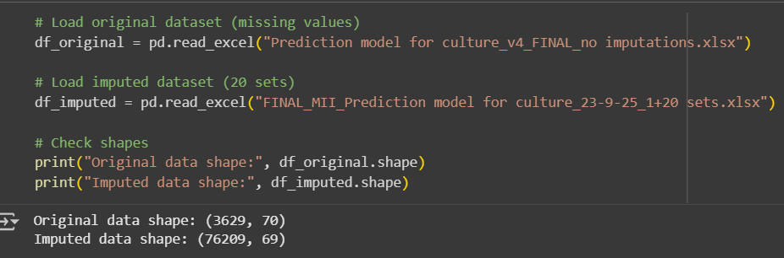
Dataset Overview
Sample Size: 3,629 patients enrolled.
Culture Results:
789 culture-positive patients.
156 contaminants (not true infections).
Lab Tests Availability:
CRP → 2,424 patients.
TLC → 2,878 patients.
ANC → 1,632 patients.
PCT → 211 patients.
Highlighting in Dataset:
Green → Culture-positive.
Blue → Culture-negative.
Reference: Sheet 2 contains full forms & codes of variables.

Slide 9
Target & Feature Variables
Dependent Variable (Outcome):
Column AV → enr_cult_org_PATHO
Binary outcome: “Yes” if genuine pathogen grown, “No” otherwise.
Derived from: AS (any organism grown) + AU (contaminant vs. true pathogen).
Independent Variables:
Columns F → AQ (all clinical & lab predictors).
Excluded: Identifiers, imputation column, antibiotic sensitivity (AW → BQ).
Rationale:
Focus on predictors available at time of diagnosis.
Avoid bias by removing post-outcome data (antibiotic sensitivity).

Slide 10
Data Cleaning & Preprocessing
Objective: Prepare dataset for reliable and unbiased modeling.
Steps Taken:
Removed patient identifiers (ID, Admission Date, etc.) to avoid data leakage.
Dropped columns not available at diagnosis (Outcome, Antibiotics given, etc.).
Checked missing values: Found in CRP, TLC, and some categorical features.
Imputation strategy:
Numeric → median imputation.
Categorical → mode imputation.
Encoding categorical variables using one-hot encoding for model compatibility.
Result: A clean dataset with consistent features ready for splitting into different cases.

Slide 11
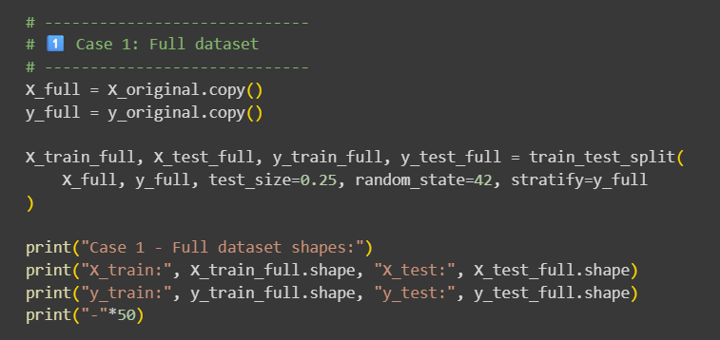
Case I – Full Dataset
Independent Variables (X):
All cleaned and encoded features (≈576).
Includes demographics, clinical info, lab markers (CRP, TLC, PCT, ANC, etc.).
Dropped identifiers and leakage variables (patient ID, state, antibiotic sensitivity, etc.).
Dependent Variable (y):
enr_cult_org_PATHO (binary outcome).
1 = pathogenic culture, 0 = non-pathogenic/contaminated.
Chosen because this is the clinical endpoint we want to predict.
Train-Test Split:
Used 75% for training, 25% for testing.
Stratified split to preserve class balance.
Reasoning:
Establishes the baseline model with maximum information.
Allows us to check if all features together give the highest possible accuracy.

Slide 12
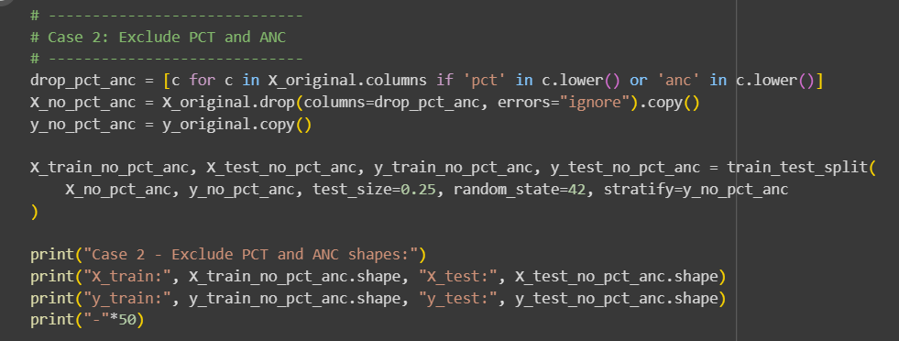
Case II – Excluding PCT & ANC
Independent Variables (X):
Same as Case i but removed PCT (Procalcitonin) & ANC (Absolute Neutrophil Count).
These two tests are often expensive, not always available, and missing frequently.
Dependent Variable (y):
Same: enr_cult_org_PATHO.
Train-Test Split:
75% training, 25% testing, stratified.
Reasoning:
Goal: Assess if model performance remains stable without PCT & ANC.
If yes → we can avoid imputing these tests and reduce dependency on unavailable markers.
My Opinion:
If removing PCT/ANC does not drop performance significantly, we should not impute them.
Imputation may add noise, especially if missingness is systematic (not random).
Clinically, CRP & TLC are more reliable and universally available than PCT/ANC.

Slide 13
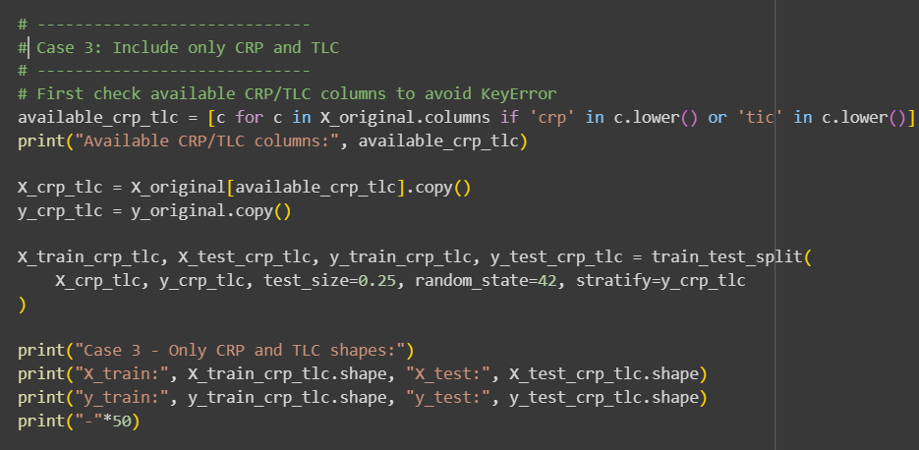
Case III – CRP & TLC Only
Independent Variables (X):
Only two lab markers:
CRP (C-Reactive Protein): Inflammation marker.
TLC (Total Leukocyte Count): Immune response marker.
Dependent Variable (y):
enr_cult_org_PATHO.
Train-Test Split:
75% training, 25% testing, stratified.
Reasoning:
Tests whether just two cheap, widely available markers can predict outcomes.
If performance is good → this is the most practical and deployable model for hospitals.
My Opinion:
This case is clinically the most meaningful, even if performance is slightly lower than Case i.
Because doctors can easily access CRP/TLC everywhere, it improves adoption.

Slide 14
Case IV – Imputed Dataset
Dataset: Multiple imputed versions provided (20 imputations).
Current Focus: Using the first imputed dataset (Imputation_ = 1) for modeling.
Features: All predictors from columns F → AQ, except:
Excluded PCT and ANC (very high missingness → unreliable imputations).
Excluded Antibiotic sensitivity (only available for culture-positive).
Advantages:
CRP & TLC missing values imputed → larger usable sample (~3,600 subjects).
Preserves data consistency across patients.
Expectation:
Better model stability and accuracy compared to original (non-imputed) dataset.

Slide 15
Opinion on PCT & ANC Imputation
Observation:
PCT (94% missing), ANC (55% missing).
Imputation on such sparse data → may create noise, not signal.
My Opinion:
Do NOT impute PCT & ANC → excluded in modeling.
Focus on CRP, TLC, and clinical predictors.
Reasoning:
Preserves dataset reliability.
Avoids artificial inflation of model accuracy.

Slide 16
Next Steps & Future Work
Train XGBoost model and Neural Networks compare with baseline classifiers.
Evaluate using:
Accuracy
ROC-AUC
Confusion Matrix
Classification Report
Compare case performance to find the best trade-off between accuracy and interpretability.
Prepare final results with visuals for presentation.

